Slide 1



Introduction to IoT
Riya G. Thakurta
WTM Kolkata Lead
Intel Software Innovator

Slide 2

What is IoT
What is IoP & IoT
What is IoT and why you should care
Why IoT is important
How IoT works
Hardware Development Platforms

Slide 3
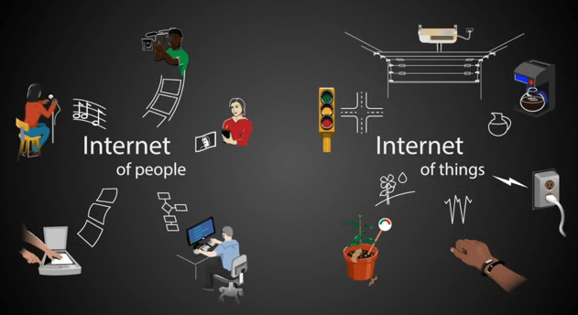

Slide 4
What is it IoT and why you should care
“...the IoT enables a myriad of applications ranging from the micro to the macro, and from the trivial to the critical”

Slide 5
Things
+
Sense & Communicate

Slide 6
Hardware Development
Platforms
for IoT

Slide 7
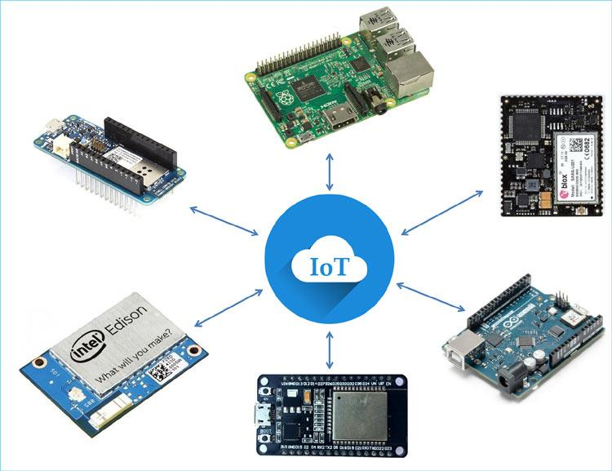

Slide 8
Basic Understanding of Hardware Components
Board connection and Installation steps
Configure the Arduino UNO Board - Atmega328
Software requirements used in the project
User Interface

Slide 9
Components you require to create your project:
1. Arduino UNO Board
2. Breadboard
3. Standard Type B USB cable x 1
4. 10K resistor x 1
5. Short jumper wires x 3

Slide 10
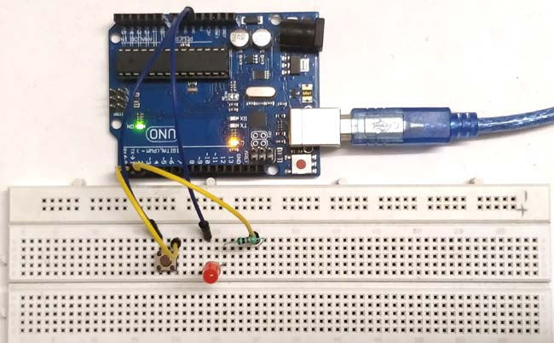
Output

Slide 11
“Face 1 new problem each week.
Make a tiny project out of it.”
_____

Slide 12
Thank You

